Slide 1
Data Science UNIT-V Forecasting Techniques
Dr. N. Subhash Chandra
Professor CSE

Slide 2
UNIT-1: Contents
UNIT V – Prescriptive Analysis
Forecasting Techniques: Time series data, Techniques, and accuracy, Moving average method, Single, double, triple exponential smoothing, Regression model for forecasting, Auto-Regression models, ARIMA Process.
Graph Analytics: Path analysis, Connectivity analysis, Community analysis, Centrality analysis, Social-Network Graphs, Communities and Clusters, Betweenness, The Girvan-Newman Algorithm.

Slide 3
What is Forecasting?
Forecasting is the process of making predictions about future events based on historical data and analysis.
It's widely used in various fields such as finance, economics, supply chain management, and meteorology. There are several techniques for forecasting, broadly categorized into qualitative and quantitative methods.

Slide 4
TIME-SERIES DATA AND COMPONENTS OF TIME-SERIES DATA
Time-series data is a data on a response variable, Yt, such as demand for a spare parts of a capital equipment or a product or a service or market share of a brand observed at different time points t.
Whenever we have a forecasting problem, we will be using a time-series data. The variable Yt is a random variable.
The data points or measurements are usually collected at regular intervals and are arranged in chronological order.
If the time-series data contains observations of just a single variable (such as demand of a product at time t), then it is termed as univariate time series.
If the data consists of more than one variable, for example, demand for a product at time t, price at time t, amount of money spent by the company on promotion at time t, competitors price at time t, etc. then it is called multivariate time-series data.

Slide 5


COMPONENTS OF TIME-SERIES DATA
Trend Component (Tt): Trend is the consistent long-term upward or downward movement of the data over a period of time.
Seasonal Component (St): Seasonal component (measured using seasonality index) is the repetitive upward or downward movement (or fluctuations) from the trend that occurs within a calendar year such as seasons, quarters, months, days of the week,
Cyclical Component (Ct): Cyclical component is fluctuation around the trend line that happens due to macro-economic changes such as recession, unemployment, etc.
Irregular Component (It): Irregular component is the white noise or random uncorrelated changes that follow a normal distribution with mean value of 0 and constant variance.
The time-series data can be modelled as an addition of the above components or product of the above components. The additive time-series model is given by

Slide 6
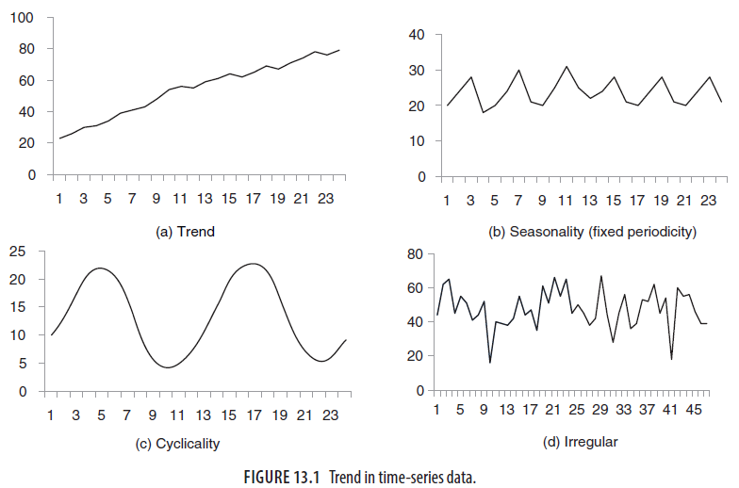
Trends in Timeseries data

Slide 7
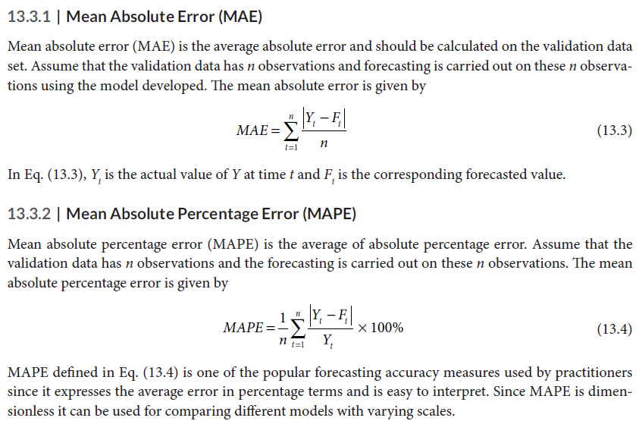
FORECASTING TECHNIQUES AND FORECASTING ACCURACY

Slide 8
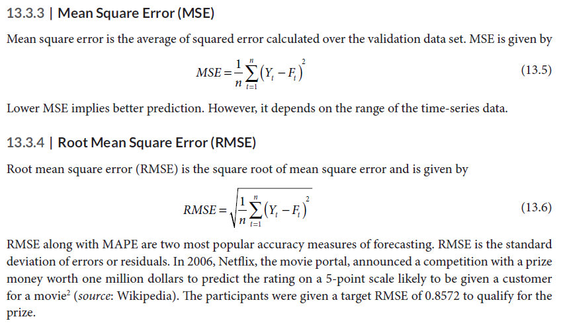
FORECASTING TECHNIQUES AND FORECASTING ACCURACY

Slide 9
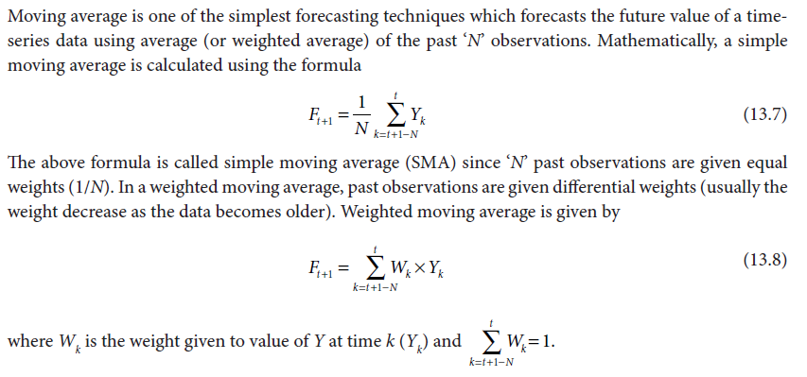
MOVING AVERAGE METHOD

Slide 10
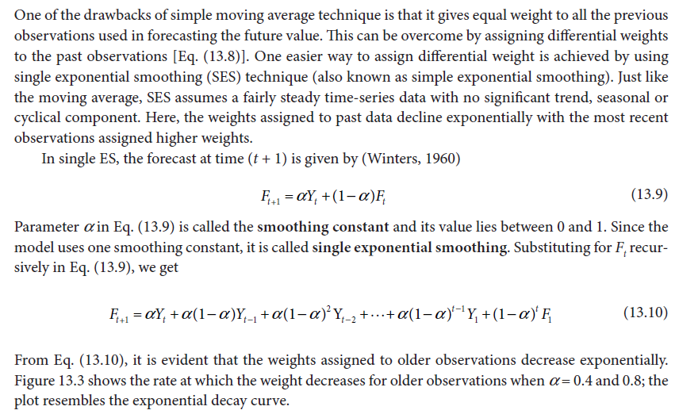
SINGLE EXPONENTIAL SMOOTHING (ES)

Slide 11
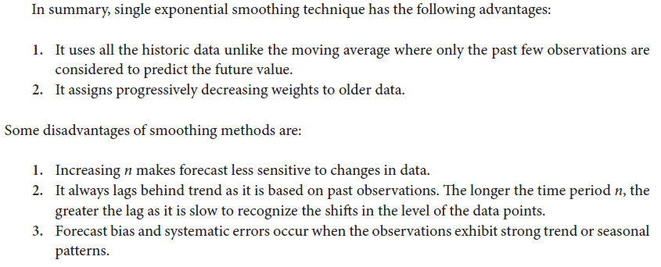
SINGLE EXPONENTIAL SMOOTHING (ES)

Slide 12
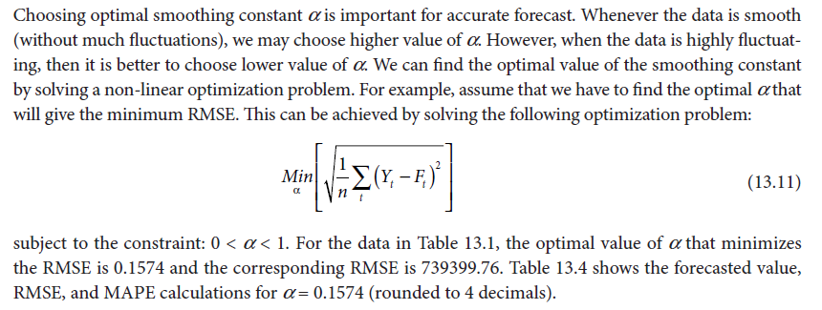
Optimal Smoothing Constant in a Single Exponential Smoothing (SES)

Slide 13
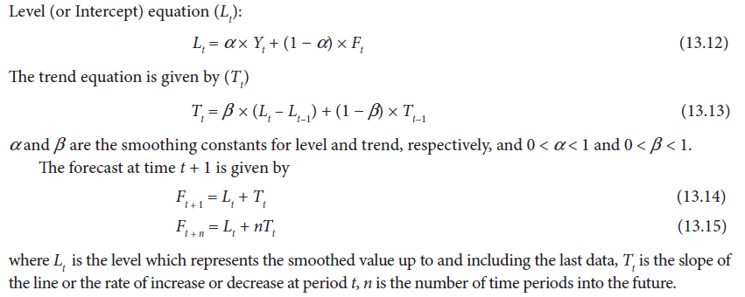
DOUBLE EXPONENTIAL SMOOTHING – HOLT’S METHOD
One of the drawbacks of single exponential smoothing is that the model does not do well in the presence
of trend. This can be improved by introducing an additional equation for capturing the trend in the
time-series data. Double exponential smoothing uses two equations to forecast the future values of the
time series, one for forecasting the level (short term average value) and another for capturing the trend.
The two equations are provided in Eqs. (13.12) and (13.13).

Slide 14
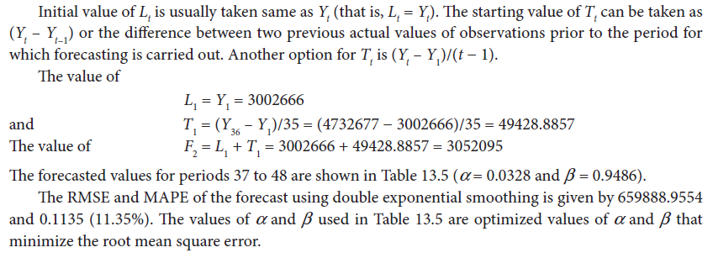

Slide 15
TRIPLE EXPONENTIAL SMOOTHING (HOLT-WINTER MODEL)
Moving averaging and single and double exponential smoothing techniques discussed so far can handle
data as long as the data do not have any seasonal component associated with it.
However, when there is seasonality in the time-series data, techniques such as moving average, exponential smoothing, and double exponential smoothing are no longer appropriate.
In most cases, the fitted error values (actual demand minus forecast) associated with simple exponential smoothing and Holt’s method will indicate systematic error patterns that reflect the existence of seasonality.
Triple exponential smoothing is used when the data has trend as well as seasonality. The following three equations which account for level, trend, and seasonality are used for forecasting (for a multiplicative model, Winters 1960):

Slide 16
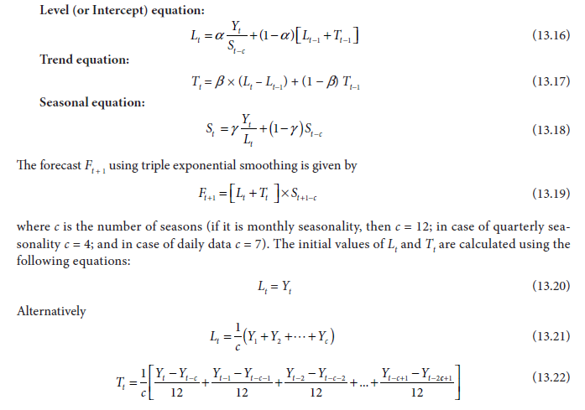

Slide 17
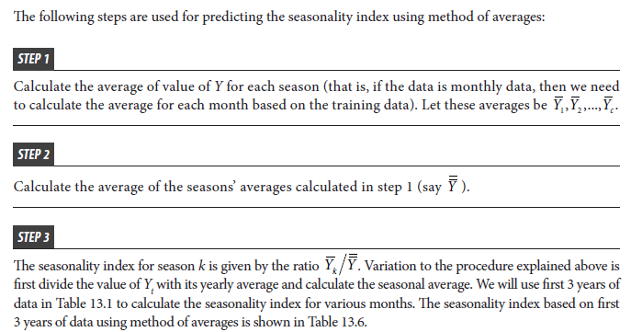
Predicting Seasonality Index Using Method of Averages

Slide 18
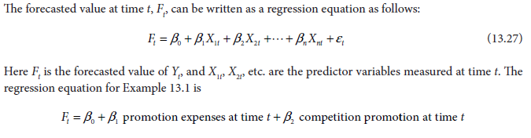
REGRESSION MODEL FOR FORECASTING

Slide 19
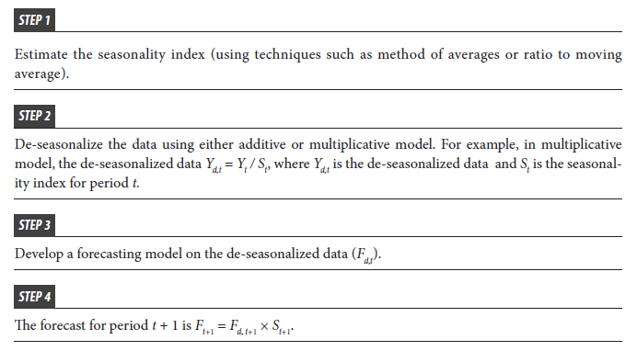
Forecasting Time-Series Data with Seasonal Variation

Slide 20
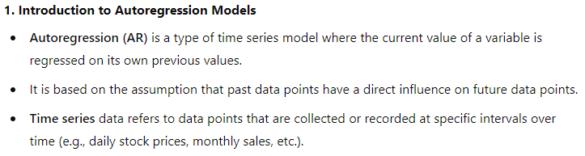
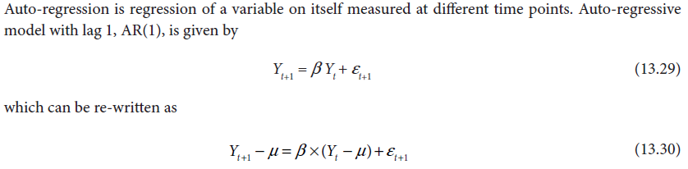
AUTO-REGRESSIVE (AR) MODELS

Slide 21
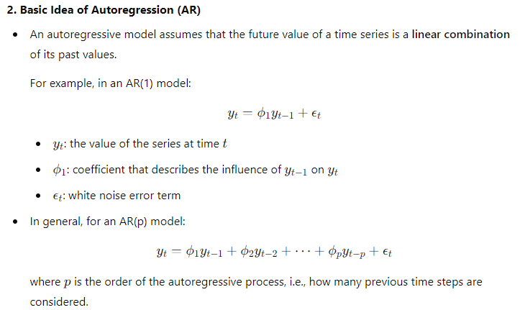

Slide 22
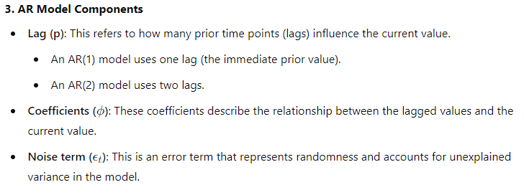
4. Stationarity Assumption
Stationarity: A key assumption of AR models is that the time series is stationary. This means that its properties (mean, variance, autocorrelation) do not change over time.
Stationarity ensures that the relationships between lags and the series are stable and meaningful over time.
If the series is non-stationary (e.g., has a trend), differencing may be applied to make it stationary before fitting an AR model.

Slide 23
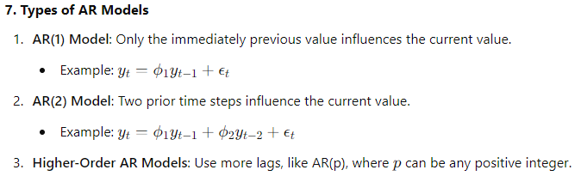
Model Estimation
Estimating an AR model involves determining the order of the model (p) and the parameters (ϕ\phiϕ).
Common methods to estimate parameters include:
Ordinary Least Squares (OLS)
Yule-Walker Equations
Maximum Likelihood Estimation (MLE)
Order Selection (p)
The order ppp of the AR model can be selected based on criteria such as:
Akaike Information Criterion (AIC)
Bayesian Information Criterion (BIC)
These criteria balance model fit and complexity (number of parameters) to avoid overfitting.

Slide 24
Forecasting with AR Models
AR models are widely used for forecasting future values of time series.
The future value is predicted based on past observations.
Forecast intervals can also be generated to represent the uncertainty in the predictions.
Limitations of AR Models
Linearity: AR models assume linear relationships between the current and lagged values.
Stationarity: They require the series to be stationary, which may not be the case in many real-world time series.
Overfitting: Including too many lags can result in overfitting, where the model captures noise rather than the underlying pattern.
Applications of AR Models
Economics and Finance: Predicting stock prices, interest rates, and inflation rates.
Weather Forecasting: Estimating future weather conditions based on historical data.
Sales Forecasting: Predicting future sales based on past trends.
Extensions of AR Models
ARMA (Autoregressive Moving Average) Models: Combine AR with a moving average (MA) component.
ARIMA (Autoregressive Integrated Moving Average) Models: Extend ARMA to handle non-stationary series using differencing.

Slide 25
Moving Average (MA) Models
Moving Average (MA) models are a type of time series model where the current value of the series is expressed as a linear combination of past error terms (also known as residuals or shocks).
In contrast to Autoregressive (AR) models, where the past values of the series itself are used, MA models use past forecast errors to explain the current observation.
Time series data involves observations taken over regular time intervals (e.g., monthly sales data, daily temperatures).
Moving Regression vs. Traditional Regression:
Traditional Regression: Assumes relationships between variables are static over time.
Moving Regression: Assumes relationships can change as time progresses, fitting models to rolling windows of data.
Better for time series forecasting in dynamic environments.

Slide 26
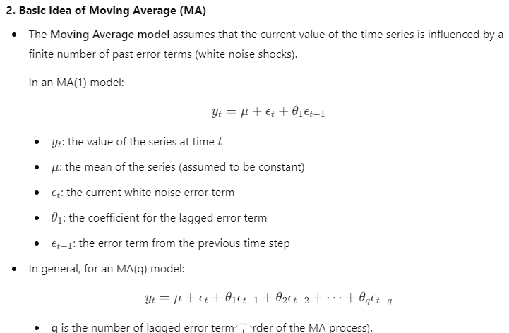

Slide 27
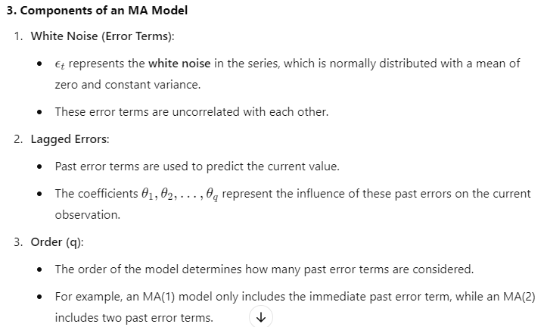

Slide 28
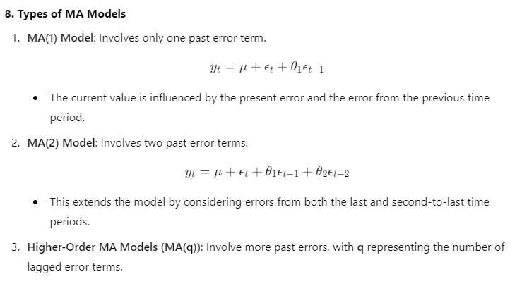
Autocorrelation Function (ACF) for MA Models
In MA models, the Autocorrelation Function (ACF) has a distinctive pattern:
For an MA(q) model, the ACF cuts off after lag q, meaning there is no significant autocorrelation beyond lag q.
This behavior helps in identifying the appropriate order qqq for the model.

Slide 29
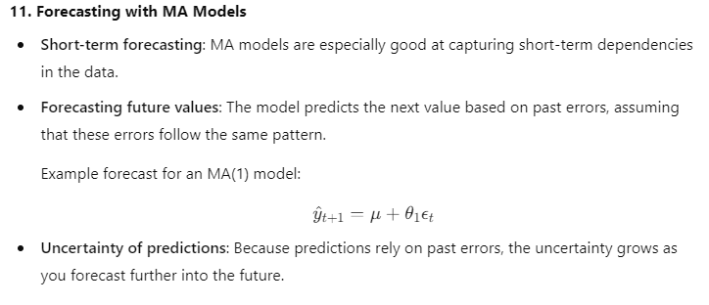
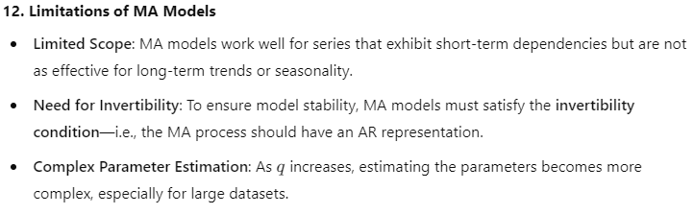

Slide 30
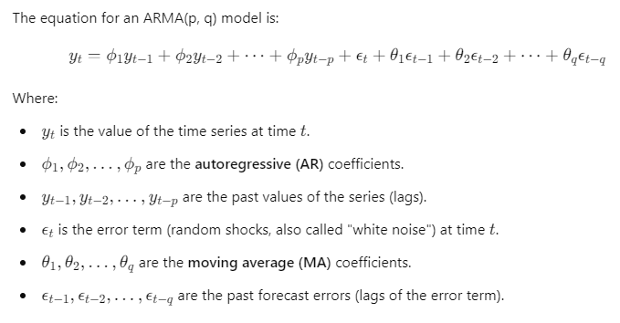
ARMA Models
Auto-regressive moving average (ARMA) is a combination auto-regressive and moving average process. ARMA(p, q) process combines AR(p) and MA(q) processes. ARMA(p, q) model is given by

Slide 31
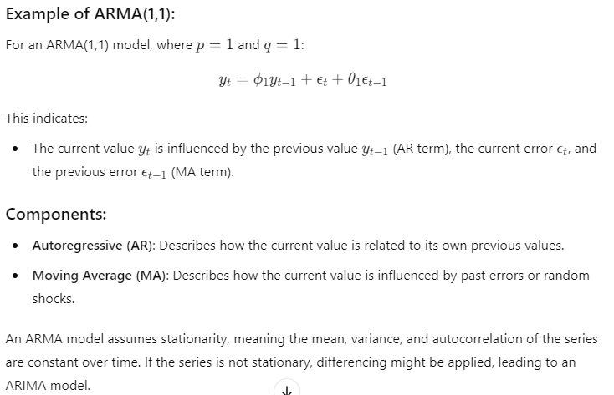

Slide 32
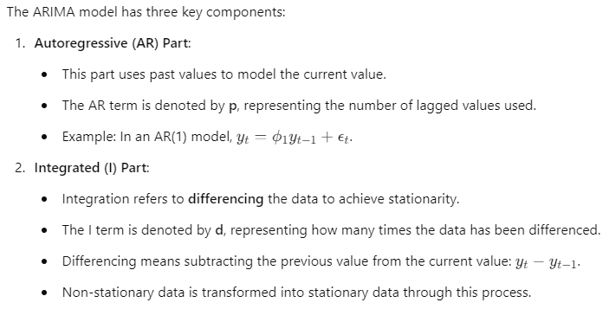
ARIMA Models
ARIMA stands for Autoregressive Integrated Moving Average.
ARIMA models are a popular class of statistical models used for time series forecasting.
They combine Autoregression (AR), Moving Average (MA), and Integration (I) to handle non-stationary time series data.
Widely used in fields like finance, economics, and environmental science.

Slide 33
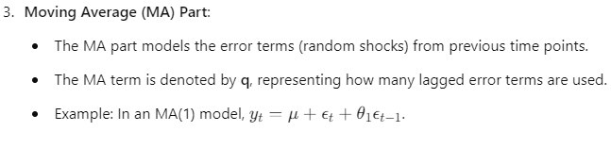
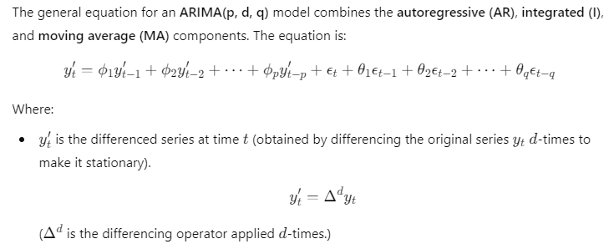

Slide 34
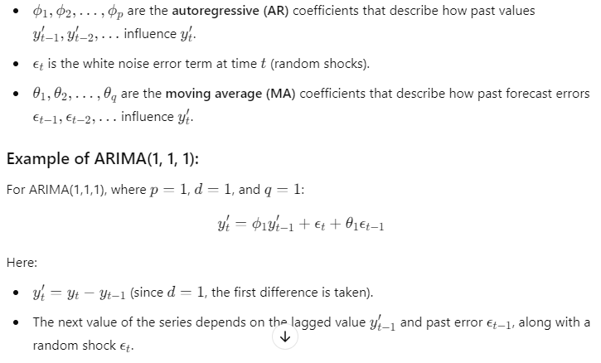

Slide 35
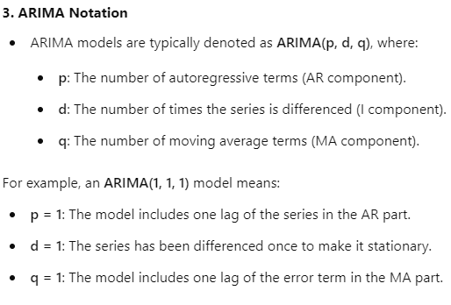

Slide 36
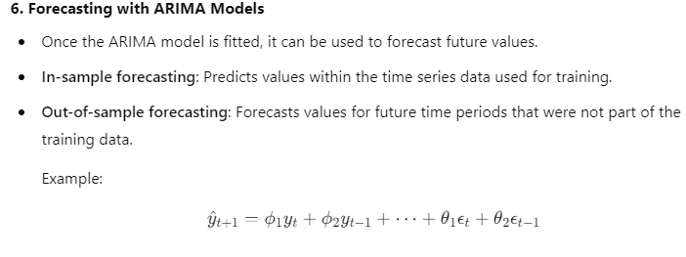

Slide 37
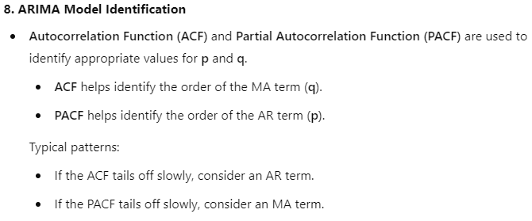
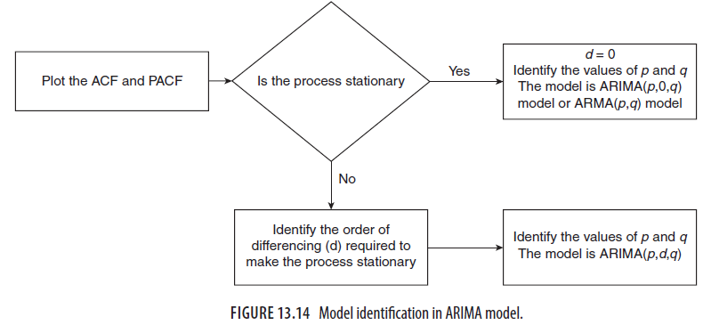

Slide 38
Seasonal ARIMA (SARIMA)
When time series data exhibits seasonality, the basic ARIMA model is extended to SARIMA (Seasonal ARIMA).
SARIMA adds seasonal components to the AR, MA, and differencing parts.
SARIMA notation is ARIMA(p, d, q)(P, D, Q)m, where:
P, D, Q are the seasonal orders for AR, differencing, and MA.
m is the number of periods per season (e.g., m = 12 for monthly data with annual seasonality).

Slide 39
Limitations of ARIMA Models:
Linear Assumption: ARIMA models assume that the relationships between past values and future values are linear.
Stationarity Requirement: The model requires stationary data, which may not always be the case.
Short-Term Forecasting: ARIMA models are typically more effective for short-term forecasts, as long-term forecasts may suffer from increasing uncertainty.
Applications of ARIMA Models:
Economics and Finance: ARIMA is used to predict stock prices, interest rates, GDP growth, and inflation.
Sales Forecasting: Retailers use ARIMA to forecast future sales based on historical data.
Environmental Science: ARIMA models are used to predict temperature changes, rainfall, and pollution levels.

Slide 40
Steps for Building an ARIMA Model:
Visualize the Data: Check for trends, seasonality, and stationarity.
Make the Series Stationary: Use differencing if necessary.
Identify Model Parameters (p, d, q): Use ACF and PACF plots to determine AR and MA components.
Fit the ARIMA Model: Estimate the parameters using MLE or other methods.
Diagnose the Model: Check residuals and perform diagnostic tests.
Forecast: Use the fitted model for future predictions.

